Slide 1


Orientation Distribution: Definition, Discrete Forms, Examples
A.D. Rollett
27-750
Texture, Microstructure & Anisotropy
Updated 27th Jan. 2016

Slide 2
Lecture Objectives
Introduce the concept of the Orientation Distribution (OD) as the quantitative description of “preferred crystallographic orientation” a.k.a. “texture”.
Explain the motivation for using the OD as something that enables calculation of anisotropic properties, such as elastic compliance, yield strength, permeability, conductivity, etc.
Illustrate discrete ODs and contrast them with mathematical functions that represent the OD, a.k.a. “Orientation Distribution Function (ODF)”.
Explain the connection between the location of components in the OD, their Euler angles and pole figure representation.
Present an example of an OD for a rolled fcc metal.
Offer preliminary (qualitative) explanation of the effect of symmetry on the OD.
Concept Params. Euler Normalize Vol.Frac. Cartesian Polar Components

Slide 3
In Class Questions: 1
Why does an orientation distribution (OD) require three parameters?
What are the similarities and differences between an OD and a probability density function?
What is the practical value of an OD (as compared to pole figures, e.g.)?
Does an OD have to be parameterized with Euler angles?
Against which Euler angles are ODs typically sectioned?

Slide 4
In Class Questions: 2
What distribution of intensity do we expect to see for a rolled fcc metal?
What is meant by the “beta fiber”?
Where are standard texture components of rolled fcc metals located in the space?
What are some differences between discrete forms of ODs and series expansion forms?
What is the size of the volume element in orientation space?

Slide 5
In Class Questions: 3
Explain how projecting on the first Euler angle yields an inverse pole figure (for the sample Z direction) and projecting on the 3rd Euler angle yields a pole figure (for the crystal Z direction).
What are generalized spherical harmonic (functions)?
How do pole figures relate to the OD?
How do volume fractions (of texture components) relate to intensity values in the OD?

Slide 6
Orientation Distribution (OD)
The Orientation Distribution (OD) is a central concept in texture analysis and anisotropy.
Normalized probability* distribution, is typically denoted by “f” in whatever space is used to parameterize orientation, g, i.e. as a function, f(g), of three variables. Typically 3 (Bunge) Euler angles are used, hence we write the OD as f(φ₁,Φ,φ₂). The OD is closely related to the frequency of occurrence of any given texture component, which means that f ≥ 0 (very important!).
Probability density (normalized to have units of multiples of a random density, or MRD) of finding a given orientation (specified by all 3 parameters) is given by the value of the OD function, f. Multiples of a uniform density, or MUD, is another exactly equivalent unit.
ODs can be defined mathematically in any space appropriate to a continuous description of rotations (Euler angles, axis-angle, Rodrigues vectors, unit quaternions). The Euler angle space is generally used because the series expansion representation depends on the generalized spherical harmonics.
Remember that the space used to describe the OD is always periodic, although this is not always obvious (e.g. in Rodrigues vector space).
In terms of data, think of taking measurements of orientation at individual points in an EBSD map (in the form of Euler angles) and binning them in a gridded orientation space, then normalizing the values in MRD units, then making contour plots.
*A typical OD(f) has a different normalization than a standard probability distribution; see later slides
Concept Params. Euler Normalize Vol.Frac. Cartesian Polar Components

Slide 7
Meaning of an OD
Each point in the orientation distribution represents a single specific orientation or texture component.
Most properties depend on the complete orientation (all 3 Euler angles matter), therefore must have the OD to predict properties. Pole figures, for example, are not enough.
Can use the OD information to determine presence/absence of components, volume fractions, predict anisotropic properties of polycrystals.
Note that we also need the microstructure in order to predict anisotropic properties.
Concept Params. Euler Normalize Vol.Frac. Cartesian Polar Components

Slide 8
Orientation Distribution Function (ODF)
A mathematical function is always available to describe the (continuous) orientation density; this is known as an “orientation distribution function” (ODF). Properly speaking, any texture can be described by an OD but “ODF” should only be used if a functional form has been fitted to the data.
From probability theory, however, remember that, strictly speaking, the term “distribution function” is reserved for the cumulative frequency curve (only used for volume fractions in this context) whereas the ODF that we shall use is actually a probability density but normalized in a different way so that a randomly (uniformly) oriented material exhibits a level (intensity) of unity. Such a normalization is different than that for a true probability density (i.e. such that the area under the curve is equal to one - to be discussed later).
Historically, ODF was associated with the series expansion method for fitting coefficients of generalized spherical harmonics [functions] to pole figure data*. The set of harmonics+coefficients constitute a mathematical function describing the texture. Fourier transforms represent an analogous operation for 1D data.
*H. J. Bunge: Z. Metall. 56, (1965), p. 872.
*R. J. Roe: J. Appl. Phys. 36, (1965), p. 2024.
Concept Params. Euler Normalize Vol.Frac. Cartesian Polar Components

Slide 9
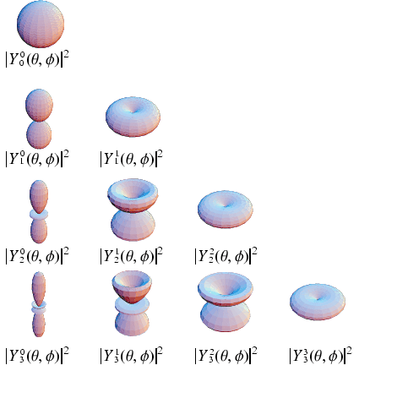
Orientation Space: Why Euler Angles?
Why use Euler angles, when many other variables could be used for orientations?
The solution of the problem of calculating ODs from pole figure data was solved by Bunge and Roe by exploiting the mathematically convenient features of the generalized spherical harmonics, which were developed with Euler angles. Finding the values of coefficients of the harmonic functions made it into a linear programming problem, solvable on the computers of the time.
Generalized spherical harmonics are the same functions used to describe electron orbitals in quantum physics.
If you are interested in a challenging mathematical problem, find a set of orthogonal functions that can be used with any of the other parameterizations (Rodrigues, quaternion etc.). See e.g. Mason, J. K. and C. A. Schuh (2008). "Hyperspherical harmonics for the representation of crystallographic texture." Acta materialia 56 6141-6155.
akbar.marlboro.edu
Look for visualization as: spherical_harmonics.mpeg
Concept Params. Euler Normalize Vol.Frac. Cartesian Polar Components

Slide 10
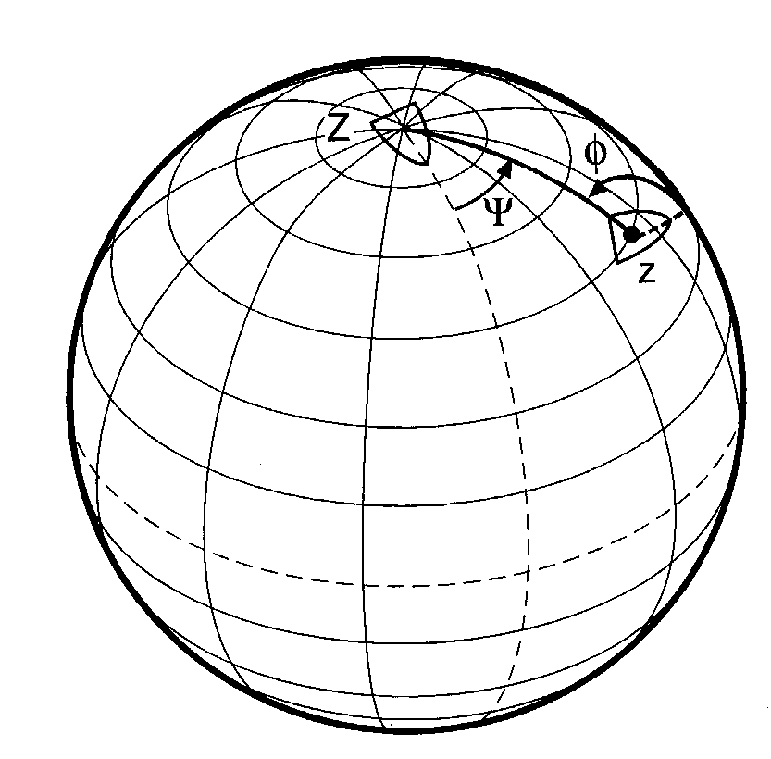
Euler Angles, Ship Analogy
Analogy: position and the heading of a boat with respect to the globe. Latitude or co-latitude (Θ) and longitude (ψ) describe the position of the boat; third angle describes the heading (φ) of the boat relative to the line of longitude that connects the boat to the North Pole.
Note the sphere always has unit radius.
[Kocks, Tomé, Wenk]
Concept Params. Euler Normalize Vol.Frac. Cartesian Polar Components

Slide 11
Area Element, Volume Element
Bunge Euler angles: Volume element = dV = dA dφ₂ = sinΦ dΦ dφ₁ dφ₂.
Spherical coordinates result in an area element whose magnitude depends on the declination (co-latitude): dA = sinΘ dΘ dψ Volume element = dV = dA dφ = sinΘ dΘ dψ dφ . (Kocks angles)
Θ
dA
[Kocks, Tomé, Wenk]
Concept Params. Euler Normalize Vol.Frac. Cartesian Polar Components

Slide 12
Description of Probability
Note the difference between probability density function (pdf), f(x), and the cumulative probability function (cdf), F(x). The example below is that of a simple (1D) misorientation distribution in the angle.
integrate
f(x)
F(x)
differentiate

Slide 13
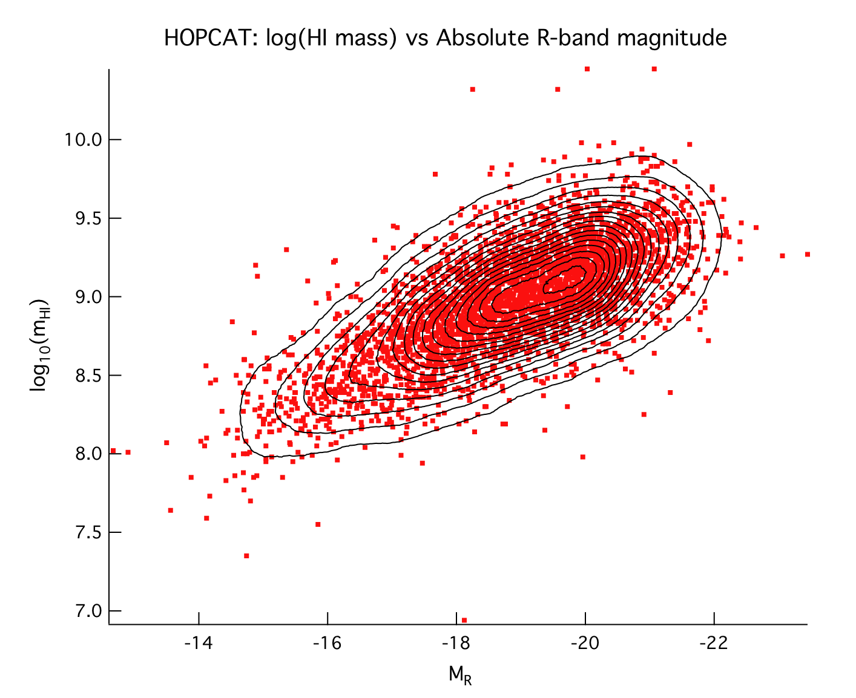
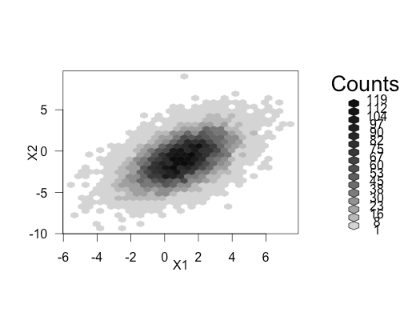
Binning Discrete Data Points
Below right: here, some counts were binned into hexagonal bins in a 2-D space and converted into a greyscale. Visit the page to get details.
http://www.r-bloggers.com/example-9-1-scatterplots-with-binning-for-large-datasets/
https://www.wavemetrics.com/products/igorpro/gallery/user_nicholls.htm
Above left: here, individual points were placed in a 2-D space. Then contours were added based on a 500² gridding that is not visible here. Visit the page to get details.

Slide 14
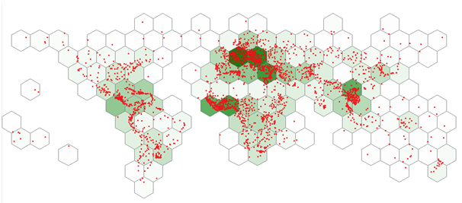
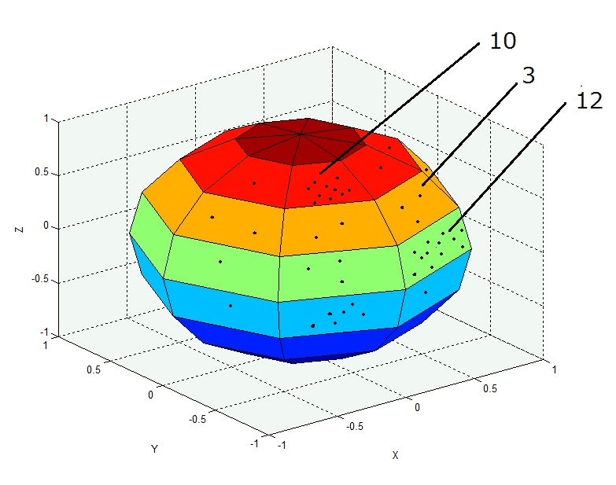
Gridding points on a Sphere
www.tatukgis.com
However, our problem with texture data is that we need to bin it on a sphere. If we use equal increments in the two angles, then the area element varies from small at the poles to large at the equator. Which is where the sin(Φ) comes from. Random points give equal area density on a sphere but the number in each cell varies.
http://stackoverflow.com/questions/26841727/histogram-from-spherical-plots-in-matlab

Slide 15
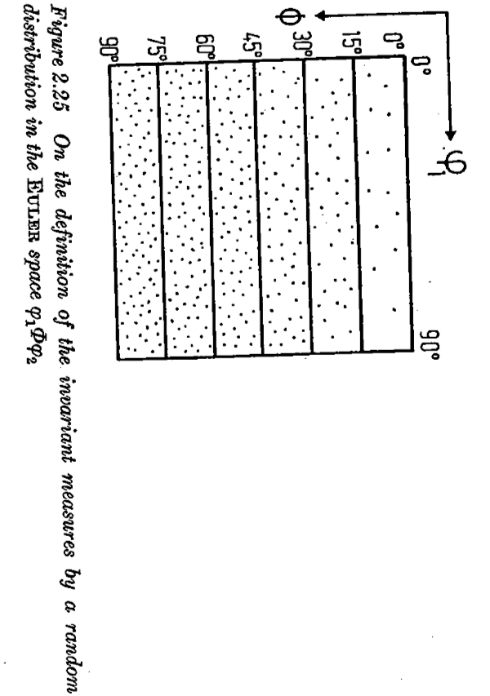
Example of random orientation distribution in Euler space
[Bunge]
Note the smaller densities of points (arbitrary scale) near Φ = 0°. When converted to intensities, however, then the result is a uniform, constant value of the OD (because of the effect of the Cartesian grid and the volume element size, sinΦdΦdφ₁dφ₂). If a material had randomly oriented grains all of the same size then this is how they would appear, as individual points in orientation space. We will investigate how to convert numbers of grains in a given region (cell) of orientation space to an intensity in a later lecture (Volume Fractions).

Slide 16
Normalization of OD
If the texture is random then the OD is defined such that it has the same value of unity everywhere, i.e. 1.
Any ODF is normalized by integrating over the space of the 3 parameters (as for pole figures).
Sine(Φ) corrects for volume of the element (previous slide). The integral of Sin(Φ) on [0,π) is 2.
Factor of 2π*2*2π = 8π² accounts for the volume of the space, based on using radian measure φ₁ = 0 - 2π, Φ = 0 - π, φ₂ = 0 - 2π. For degrees and the equivalent ranges (360, 180, 360°), the factor is 360°*2*360° = 259,200 (°²).
Concept Params. Euler Normalize Vol.Frac. Cartesian Polar Components

Slide 17
PDF versus ODF
So, what is the difference between an ODF and a pdf (probability density function, as used in statistics)?
First, remember that any orientation function is defined over a finite range of the orientation parameters (because of the periodic nature of the space).
Note the difference in the normalization based on integrals over the whole space, where the upper limit of W signifies integration over the whole range of orientation space: integrating the PDF produces unity, regardless of the choice of parameterization, whereas the result of integrating the ODF depends on both the choice of parameters and the range used (i.e. the symmetries that are assumed) but is always equal to the volume of the space.
Why do we use different normalization from that of a PDF? The answer is mainly one of convenience: it is much easier to compare ODFs in relation to a uniform/random material and to avoid the dependence on the choice of parameters and their range.
Note that the periodic nature of orientation space means that definite integrals can always be performed, in contrast to many probability density functions that extend to infinity (in the independent variable).
Statistics: pdf→
Texture: ODF→

Slide 18
Discrete versus Continuous Orientation Distributions
As with any distribution, an OD can be described either as a continuous function (such as generalized spherical harmonics) or in a discrete form.
Continuous form: Pro: for weak to moderate textures, harmonics are efficient (few numbers) and convenient for calculation of properties, automatic smoothing of experimental data; Con: unsuitable for strong (single crystal) textures, only available (effectively) for Euler angles.
Discrete form: Pro: effective for all texture strengths, appropriate to annealed microstructures (discrete grains), available for all parameters; Con: less efficient for weak textures.
Concept Params. Euler Normalize Vol.Frac. Cartesian Polar Components

Slide 19
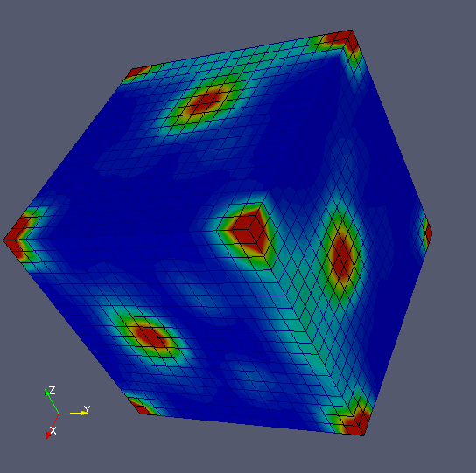
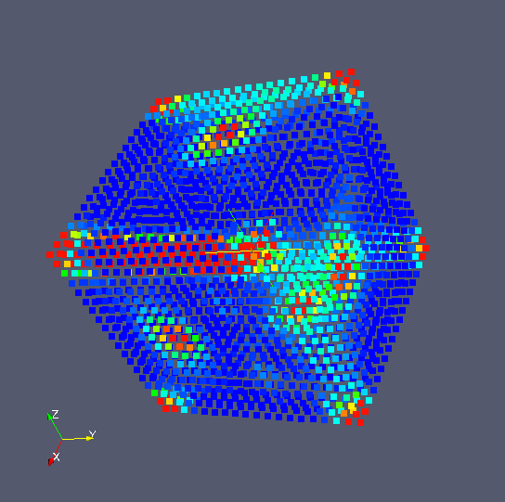
Standard 5x5x5° Discretization
The standard discretization (in the popLA package, for example) is a regular 5° grid (uniformly spaced in all 3 angles) in Euler space.
Illustrated for the texture in “demo” which is a rolled and partially recrystallized copper. {x,y,z} are the three Bunge Euler angles. The lower view shows individual points to make it more clear that, in a discrete OD, an intensity is defined at each point on the grid.
3D views with Paraview using demo.vtk as input (available on the 27-750 website, almost at the bottom of the page). Try thresholding the image for yourself.
Concept Params. Euler Normalize Vol.Frac. Cartesian Polar Components

Slide 20
Discrete OD
Real data is available in discrete form e.g. from EBSD.
Normalization also required for discrete OD, just as it was for pole figures.
Define a cell size (typically ∆[angle]= 5°) in each angle.
Sum the intensities over all the cells in order to normalize and obtain an intensity (similar to a probability density, but with a different normalization in order to get units of MRD).
Concept Params. Euler Normalize Vol.Frac. Cartesian Polar Components

Slide 21
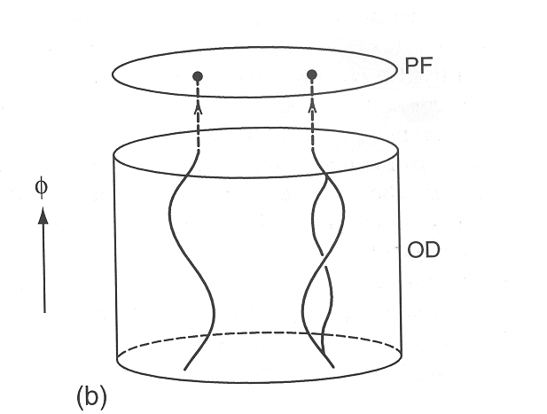
PFs ⇄ OD
Kocks Ch. 3, fig. 1
A pole figure is a projection of the information in the orientation distribution, i.e. many points in an ODF map onto a single point in a PF.
Equivalently, can integrate along a line in the OD to obtain the intensity in a PF.
The path in orientation space is, in general, a curve in Euler space. In Rodrigues space, however, it is always a straight line (which was exploited by Dawson - see N. R. Barton, D. E. Boyce, P. R. Dawson: Textures and Microstructures Vol. 35, (2002), p. 113.).
Concept Params. Euler Normalize Vol.Frac. Cartesian Polar Components

Slide 22
Distribution Functions and Volume Fractions
Recall the difference between probability density functions and probability distribution functions, where the latter is the cumulative form.
For ODs, which are like probability densities, integration over a range of the parameters (Euler angles, for example) gives us a volume fraction (equivalent to the cumulative probability function).
Note that the typical 1-parameter Misorientation Distribution, based on just the misorientation angle, is actually a probability density function, perhaps because it was originally put in this form by Mackenzie (Mackenzie, J. K. (1958). "Second paper on statistics associated with the random orientation of cubes." Biometrica 45 229-240). This is the only type of texture plot that is a true probability density function (as in statistics). We will discuss misorientations in later lectures.
Concept Params. Euler Normalize Vol.Frac. Cartesian Polar Components

Slide 23
Grains, Orientations, and the OD
Given a knowledge of orientations of discrete points in a body with volume V, OD given by: Given the orientations and volumes of the N (discrete) grains in a body, OD given by:
Concept Params. Euler Normalize Vol.Frac. Cartesian Polar Components

Slide 24
Volume Fractions from Intensity in the [continuous] OD
where Ω denotes the entire orientation space, and dΩ denotes the region around the texture component of interest. For specific ranges of Euler angles:
Volume fractions will be discussed in more detail in a later lecture.
Concept Params. Euler Normalize Vol.Frac. Cartesian Polar Components

Slide 25
Intensity from Volume Fractions
Objective: given information on volume fractions (e.g. numbers of grains of a given orientation), how do we calculate the intensity in the OD? Answer: just as we differentiate a cumulative probability distribution to obtain a probability density, so we differentiate the volume fraction information:
• General relationships, where f and g have their usual meanings, V is volume and V_{f} is volume fraction:
Concept Params. Euler Normalize Vol.Frac. Cartesian Polar Components

Slide 26
Intensity from V_{f}, contd.
For 5°x5°x5° discretization within a 90°x90°x90° volume, we can particularize to:
Concept Params. Euler Normalize Vol.Frac. Cartesian Polar Components

Slide 27
Representation of the OD
Challenging issue!
Typical representation: Cartesian plot (orthogonal axes) of the intensity in Euler [angle] space.
Standard but unfortunate choice: Euler angles, which are inherently spherical (globe analogy).
Recall the Area/Volume element: points near the origin are distorted (too large area).
Mathematically, as the second angle approaches zero, the 1st and 3rd angles become linearly dependent. At Φ = 0, only φ₁+φ₂ (or φ₁-φ₂) is significant.
Concept Params. Euler Normalize Vol.Frac. Cartesian Polar Components

Slide 28
OD Example
Will use the example of texture in rolled fcc metals.
Symmetry of the fcc crystal and the sample (i.e. cubic-orthorhombic) allows us to limit the space to a 90x90x90° region (see the discussion in the lecture on symmetry).
Intensity is limited, approximately to lines in the space, called [partial] fibers.
Since we dealing with intensities in a 3-parameter space, it is convenient to take sections through the space and make contour maps.
Example has sections with constant φ₂.
Concept Params. Euler Normalize Vol.Frac. Cartesian Polar Components

Slide 29
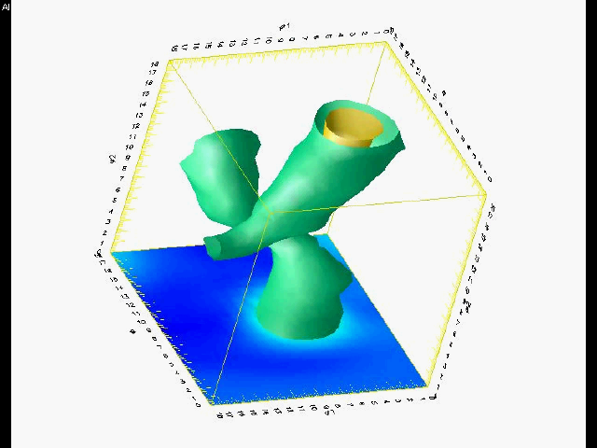
3D Animation in Euler Space
Rolled commercial purity Al
Animation made with DX - see www.opendx.org
φ₂
Φ
φ₁
Animation shows a slice progressing up in φ₂; each slice is drawn at a 5° interval (slice number 18 = 90°)

Slide 30
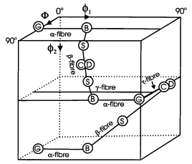
Cartesian Euler Space
Line diagram shows a schematic of the beta-fiber typically found in an fcc rolling texture with major components labeled (see legend below). The fibers labeled “alpha” and “gamma” correspond to lines of high intensity typically found in rolled bcc metals.
φ₁
Φ
G: Goss
B: Brass
C: Copper
D: Dillamore
S: “S” component
φ₂
[Humphreys & Hatherley]
Concept Params. Euler Normalize Vol.Frac. Cartesian Polar Components

Slide 31
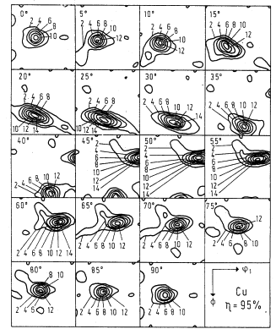
OD Sections
φ₂ = 5°
φ₂ = 15°
φ₂ = 0°
φ₂ = 10°
Example of copper rolled to 90 % reduction in thickness (ε ~ 2.5)
[Bunge]
Φ
φ₁
G
B
S
D
C
φ₂
[Humphreys & Hatherley]
Sections are drawn as contour maps, one per value of φ₂ (0, 5, 10 … 90°).
Concept Params. Euler Normalize Vol.Frac. Cartesian Polar Components

Slide 32
Example of OD in Bunge Euler Space
φ₁
Section at 15°
[Bunge]
• OD is represented by a series of sections, i.e. one (square) box per section.
• Each section shows the variation of the OD intensity for a fixed value of the third angle.
• Contour plots interpolate between discrete points.
• High intensities mean that the corresponding orientation is common (occurs frequently).
Φ
Concept Params. Euler Normalize Vol.Frac. Cartesian Polar Components

Slide 33
Example of OD in Bunge Euler Space, contd.
[Bunge]
G
B
This OD shows the texture of a cold rolled copper sheet. Most of the intensity is concentrated along a fiber.
Think of “connect the dots!” The technical name for this is the beta fiber.
S
DC
Concept Params. Euler Normalize Vol.Frac. Cartesian Polar Components

Slide 34
Numerical ⇄ Graphical
φ₁
[Bunge]
Φ
φ₂ = 45°
Example of a single section
Concept Params. Euler Normalize Vol.Frac. Cartesian Polar Components

Slide 35
(Partial) Fibers in fcc Rolling Textures
C = Copper
φ₁
B = Brass
φ₂
Φ
[Bunge]
[Humphreys & Hatherley]
Concept Params. Euler Normalize Vol.Frac. Cartesian Polar Components

Slide 36
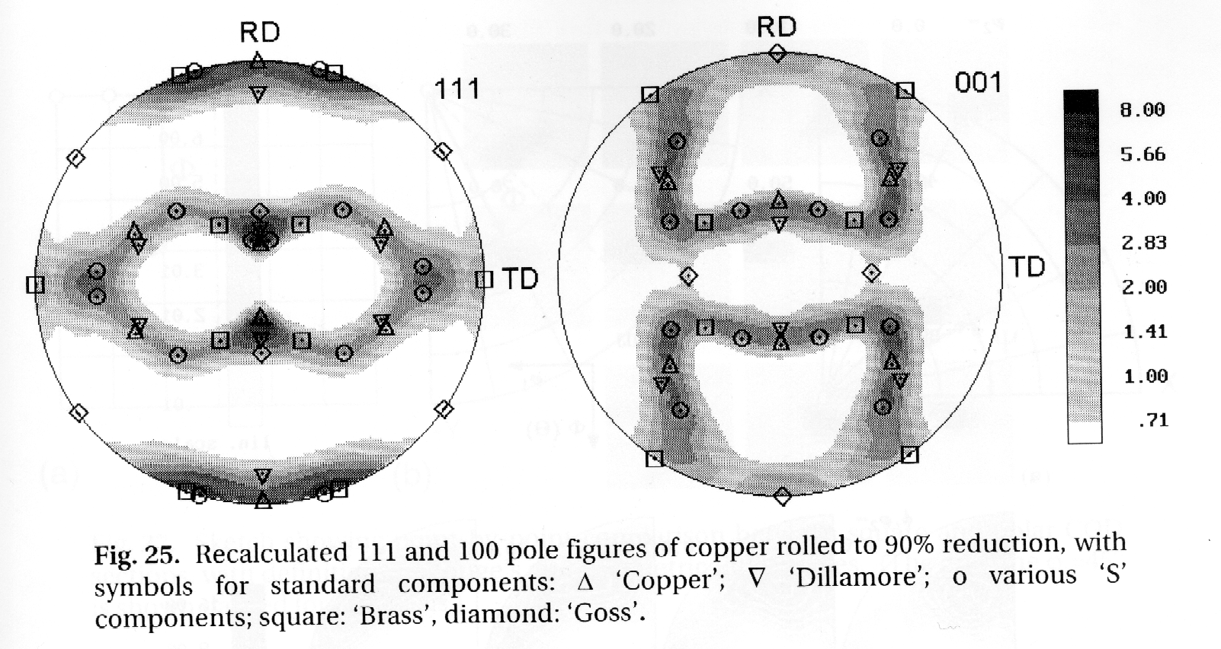
OD ⇄ Pole Figure
φ₂ = 45°
[Kocks, Tomé, Wenk]
φ₁
Φ
B = Brass
C = Copper
Note that any given component that is represented as a point in orientation space occurs in multiple locations in each pole figure.
Concept Params. Euler Normalize Vol.Frac. Cartesian Polar Components

Slide 37
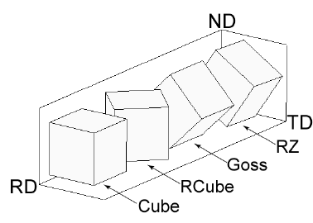
Euler Angles: recap
Euler Angles represent a crystal orientation with respect to sample axes
Sample Axes
<100>
ND
<100>
100
Crystal Axes
{011}
010
{001}
RD
a
Component | RD | ND
Cube | <100> | {001}
Goss | <100> | {011}
Brass | <112> | {110}
Copper | <111> | {112}
001
TD
Rotation 1 (φ₁): rotate sample axes about ND
Rotation 2 (Φ): rotate sample axes about rotated RD
Rotation 3 (φ₂): rotate sample axes about rotated ND
Slide courtesy of Lin Hu [2011]

Slide 38
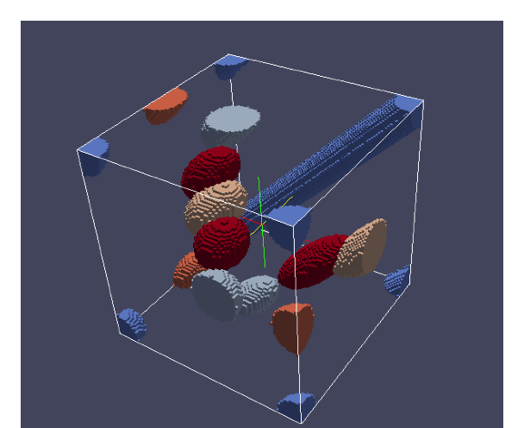
Texture Components versus Orientation Space
<100>
Cube {100}<001> (0, 0, 0)
<100>
Goss
{110}<001>
(0, 45, 0)
{011}
Brass
{110}<-112>
(35, 45, 0)
010
{001}
a
Component | Euler Angles (°)
Cube | (0, 0, 0)
Goss | (0, 45, 0)
Brass | (35, 45, 0)
Copper | (90, 45, 45)
001
Rotation 1 (φ₁): rotate sample axes about ND
Rotation 2 (Φ): rotate sample axes about rotated RD
Rotation 3 (φ₂): rotate sample axes about rotated ND
Φ
φ₁
φ₂
Orientation Space
Slide courtesy of Lin Hu [2011]

Slide 39
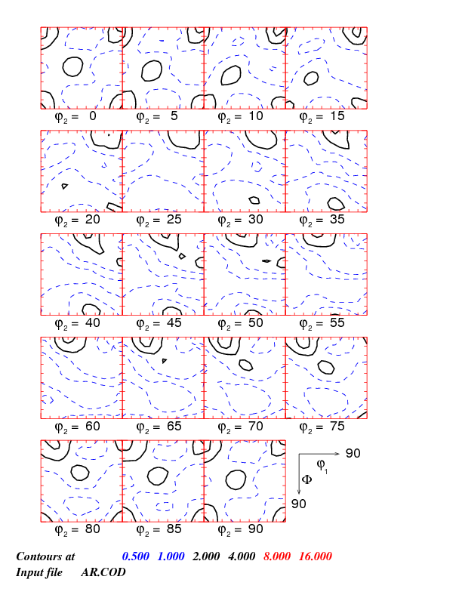
ODF: 3D vs. sections
ODF gives the density of grains having a particular orientation.
ODF
Orientation Distribution Function f (g)
Cube {100}<001> (0, 0, 0)
Goss
{110}<001>
(0, 45, 0)
Brass
{110}<-112>
(35, 45, 0)
Φ
φ₁
g = {φ₁, Φ, φ₂}
φ₂
Slide courtesy of Lin Hu [2011]

Slide 40
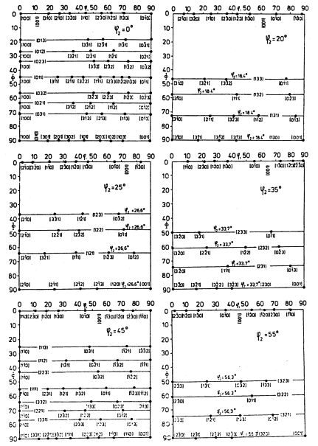
Miller Index Map in Euler Space
Bunge, p.23 et seq.
Concept Params. Euler Normalize Vol.Frac. Cartesian Polar Components

Slide 41
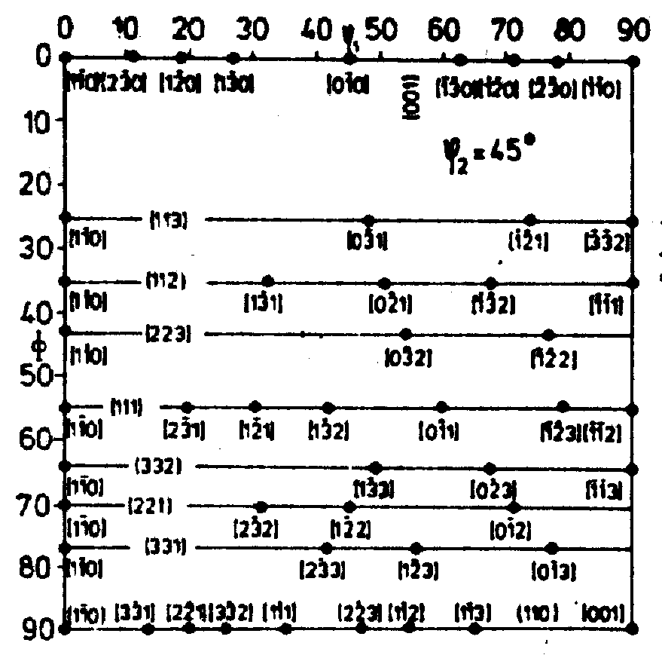
φ₂ = 45° section, Bunge angles
Alpha fiber
Copper
Gamma fiber
Brass
Goss
Concept Params. Euler Normalize Vol.Frac. Cartesian Polar Components

Slide 42
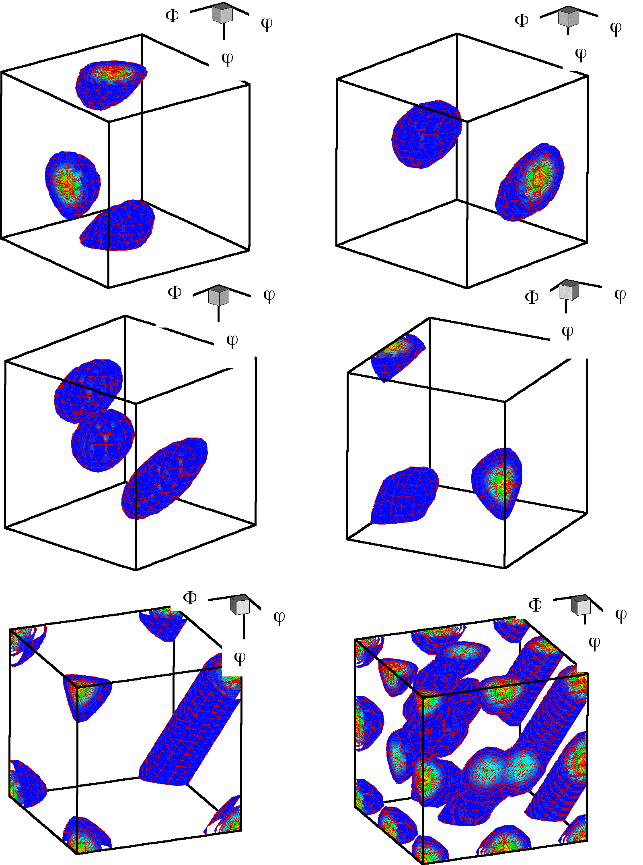
3D Views
a) Brass b) Copper c) S d) Goss e) Cube f) combined texture
1: {35, 45, 90}, brass,
2: {55, 90, 45}, brass
3: {90, 35, 45}, copper,
4: {39, 66, 27}, copper
5: {59, 37, 63}, S,
6: {27, 58, 18}, S,
7: {53, 75, 34}, S
8: {90, 90, 45}, Goss 9: {0, 0, 0}, cube 10: {45, 0, 0}, rotated cube
Figure courtesy of Jae Hyung Cho

Slide 43
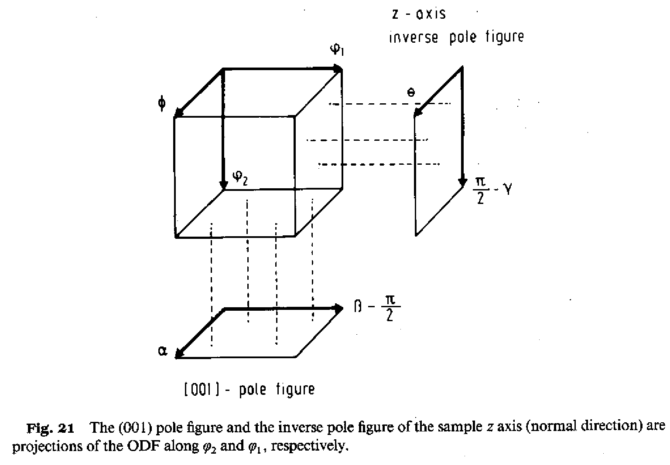
SOD versus COD
An average of the SOD made by averaging over the 1st Euler angle, φ₁, gives the inverse pole figure for the sample-Z (ND) direction.
An average of the COD made by averaging over the 3rd Euler angle, φ₂, gives the pole figure for the crystal-Z (001) direction.
One could section or slice Euler space on any of the 3 axes. By convention, only sections on the 1st or 3rd angle are used. If φ₁ is constant in a section, then we call it a Sample Orientation Distribution, because it displays the positions of sample directions relative to the crystal axes. Conversely, sections with φ₂ constant we call it a Crystal Orientation Distribution, because it displays the positions of crystal directions relative to the sample axes.
Concept Params. Euler Normalize Vol.Frac. Cartesian Polar Components

Slide 44
Section Conventions
[Kocks, Tomé, Wenk]
Concept Params. Euler Normalize Vol.Frac. Cartesian Polar Components

Slide 45
Summary
The concept of the orientation distribution has been explained.
The discretization of orientation space has been explained.
Cartesian plots have been contrasted with polar plots.
An example of rolled fcc metals has been used to illustrate the location of components and the characteristics of an orientation distribution described as a set of intensities on a regular grid in Euler [angle] space.
For correct interpretation of texture results in rolled materials, you must align the RD with the X direction (sample-1)!
Remember that each deformation type (rolling vs. drawing vs. shear) and each crystal lattice has its own set of typical texture components.

Slide 46
Supplemental Slides

Slide 47
Texture Components
Many components have names to aid the memory.
Specific components in Miller index notation have corresponding points in Euler space, i.e. fixed values of the three angles.
Lists of components: the Rosetta Stone of texture!
Very important: each component occurs in more than one location because of the combined effects of crystal and sample symmetry!!
Concept Params. Euler Normalize Vol.Frac. Cartesian Polar Components

Slide 48
Texture Component Table
In the following slide, there are four columns.
Each component is given in Bunge and in Kocks angles.
In addition, the values of the angles are given for two different relationships between Materials axes and Instrument axes.
Instrument axes means the Cartesian axes to which the Euler angles are referred to. In terms of Miller indices, (hkl)//3, and [uvw]//1.
The difference between these two settings is not always obvious in a set of pole figures, but can cause considerable confusion with Euler angle values.
TD
RD=1
2
RD
1
RD=2
RD
2
TD
1

Slide 49
[Kocks, Tomé, Wenk]
Concept Params. Euler Normalize Vol.Frac. Cartesian Polar Components

Slide 50
Need for 3 Parameters
Another way to think about orientation: rotation through θ about an arbitrary axis, n; this is called the axis-angle description.
Two numbers required to define the axis, which is a unit vector.
One more number required to define the magnitude of the rotation.
Reminder! Positive rotations are anticlockwise = counterclockwise!
Concept Params. Euler Normalize Vol.Frac. Cartesian Polar Components

Slide 51
Sets of Randomly Chosen Orientations
A reasonable question to ask, or something that one needs from time to time, is how best to generate a randomly chosen set of orientations, that, when converted into an OD, yields a uniform distribution?
We assume that the reader is familiar with how to invoke a “random number generator” on a computer (e.g. “RAND”), and that such functions are pseudo-random in the sense that they produce a sequence of values between 0 and 1 with uniform density over that interval in a sequence that has minimal regularity.
The safest procedure is to generate random values of the Euler angles over the full range (no symmetry included). Thus: { 2π*RAND , acos(2*RAND-1) , 2π*RAND }.
Note that very large numbers of points are required in order to obtain an OD with intensities close to 1, especially near Φ=0 where the data becomes sparse.

Slide 52
Polar OD Plots
As an alternative to the (conventional) Cartesian plots, Kocks & Wenk developed polar plots of ODs.
Polar plots reflect the spherical nature of the Euler angles, and are similar to pole figures (and inverse pole figures).
Caution: they are best used with angular parameters similar to Euler angles, but with sums and differences of the 1st and 3rd Euler angles.
Concept Params. Euler Normalize Vol.Frac. Cartesian Polar Components

Slide 53
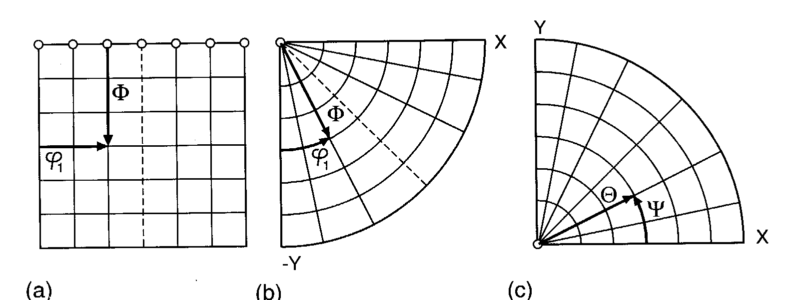
Polar versus Cartesian Plots
[Kocks, Tomé, Wenk]
Diagram showing the relationship between coordinates in square (Cartesian) sections, polar sections with Bunge angles, and polar sections with Kocks angles.
Concept Params. Euler Normalize Vol.Frac. Cartesian Polar Components

Slide 54
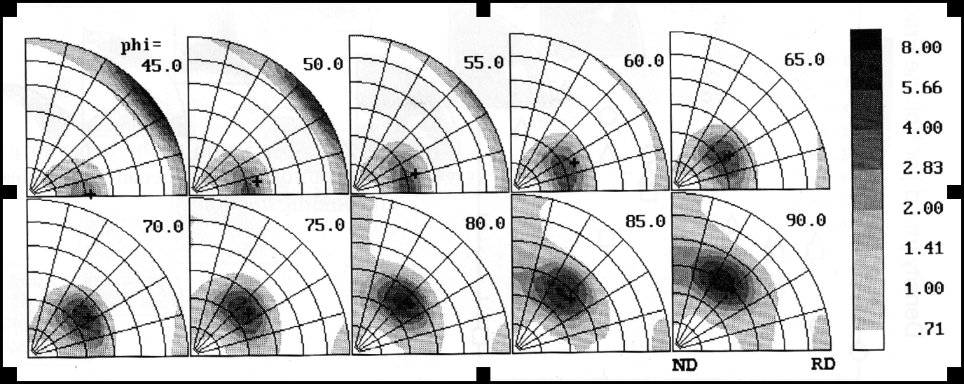
Continuous Intensity Polar Plots
Copper
S
Goss
Brass
COD sections (fixed third angle, φ) for copper cold rolled to 58% reduction in thickness. Note that the maximum intensity in each section is well aligned with the beta fiber (denoted by a "+" symbol in each section).
[Kocks, Tomé, Wenk]
Concept Params. Euler Normalize Vol.Frac. Cartesian Polar Components
Notes:
introduce the subject of fibers as a general case, unlike film textures

Slide 55
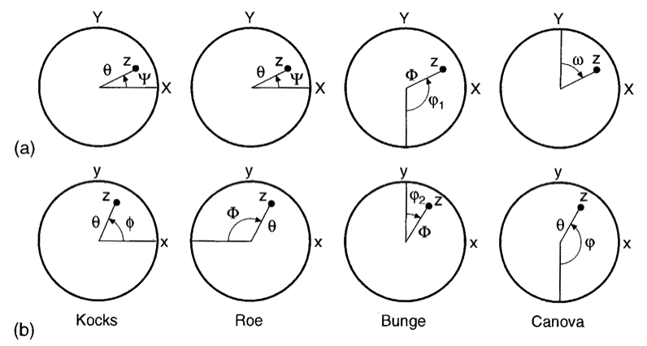
Euler Angle Conventions
[Kocks, Tomé, Wenk]
Specimen Axes “COD”
Crystal Axes “SOD”
Bunge and Canova are inverse to one another Kocks and Roe differ by sign of third angle Bunge and Canova rotate about x’, Kocks, Roe, Matthis about y’ (2nd angle).
Concept Params. Euler Normalize Vol.Frac. Cartesian Polar Components

Slide 56
Where is the RD? (TD, ND…)
[Kocks, Tomé, Wenk]
TD
TD
TD
TD
RD
RD
RD
RD
Kocks Roe Bunge Canova
In spherical COD plots, the rolling direction is typically assigned to Sample-1 = X. Thus a point in orientation space represents the position of [001] in sample coordinates (and the value of the third angle in the section defines the rotation about that point). Care is needed with what “parallel” means: a point that lies between ND and RD (Y=0°) can be thought of as being “parallel” to the RD in that its projection on the plane points towards the RD.
Concept Params. Euler Normalize Vol.Frac. Cartesian Polar Components

Slide 57
Where is the RD? (TD, ND…)
RD
TD
In Cartesian COD plots (φ₂ constant in each section), the rolling direction is typically assigned to Sample-1 = X, as before. Just as in the spherical plots, a point in orientation space represents the position of [001] in sample coordinates (and the value of the third angle in the section defines the rotation about that point). The vertical lines in the figure show where orientations “parallel” to the RD and to the TD occur. The (distorted) shape of the Cartesian plots means, however, that the two lines are parallel to one another, despite being orthogonal in real space.
Concept Params. Euler Normalize Vol.Frac. Cartesian Polar Components

Slide 58
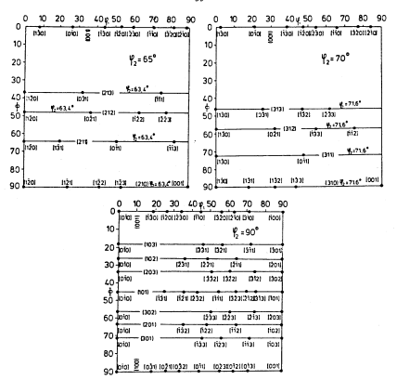
Miller Index Map, contd.
Concept Params. Euler Normalize Vol.Frac. Cartesian Polar Components

